Slide 1
Merging T₁ weighted images with Quantitative Susceptibility Mapping provides a unique contrast for brain tissue segmentation in humans and non-human primates
Rakshit Dadarwal and Susann Boretius
Functional Imaging Laboratory, German Primate Center, Göttingen, Germany
Georg-August University of Göttingen, Göttingen, Germany
rdadarwal@dpz.eu
@RakshitDadarwal

Slide 2
Declaration of Financial Interests or Relationships
Speaker Name: Rakshit Dadarwal
I have no financial interests or relationships to disclose with regard to the subject matter of this presentation.

Slide 3
Introduction Methods Results Conclusions
T₁w contrast provides an excellent gray-white matter contrast
However, minimal contrast to discern between the subcortical zone and the white matter
Major subcortical structures are incorrectly classified as white matter

Slide 4
Introduction Methods Results Conclusions

Slide 5
Introduction Methods Results Conclusions
Goal:
Increase subcortical contrast while maintaining T₁w gray-white matter contrast

Slide 6
Introduction Methods Results Conclusions
Human T₁w and T₂*w data were acquired in 13 minutes.

Slide 7
Introduction Methods Results Conclusions
QSM

Slide 8
Introduction Methods Results Conclusions
TQ-SILiCON – T₁w - QSM Synthetic Images via a Linearly-weighted combination of CONtrasts
W (weights) = random(-1, 1)
X (T₁w & QSM intensities) = norm(0, 1)
i = number of generated images
$$Yi=\sum_{c=0}^{1}{Wic Xc}$$

Slide 9
Introduction Methods Results Conclusions
TQ-SILiCON images

Slide 10
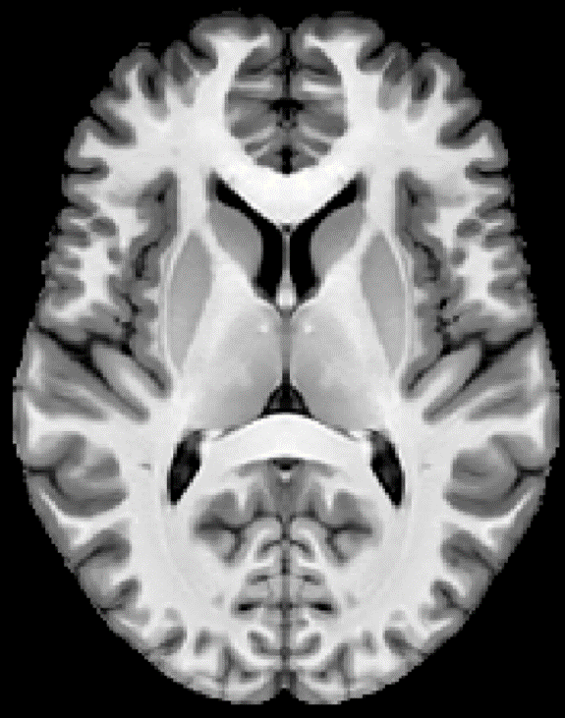
Introduction Methods Results Conclusions
Selection of best weights
Contrast-to-noise ratio (CNR)

Slide 11
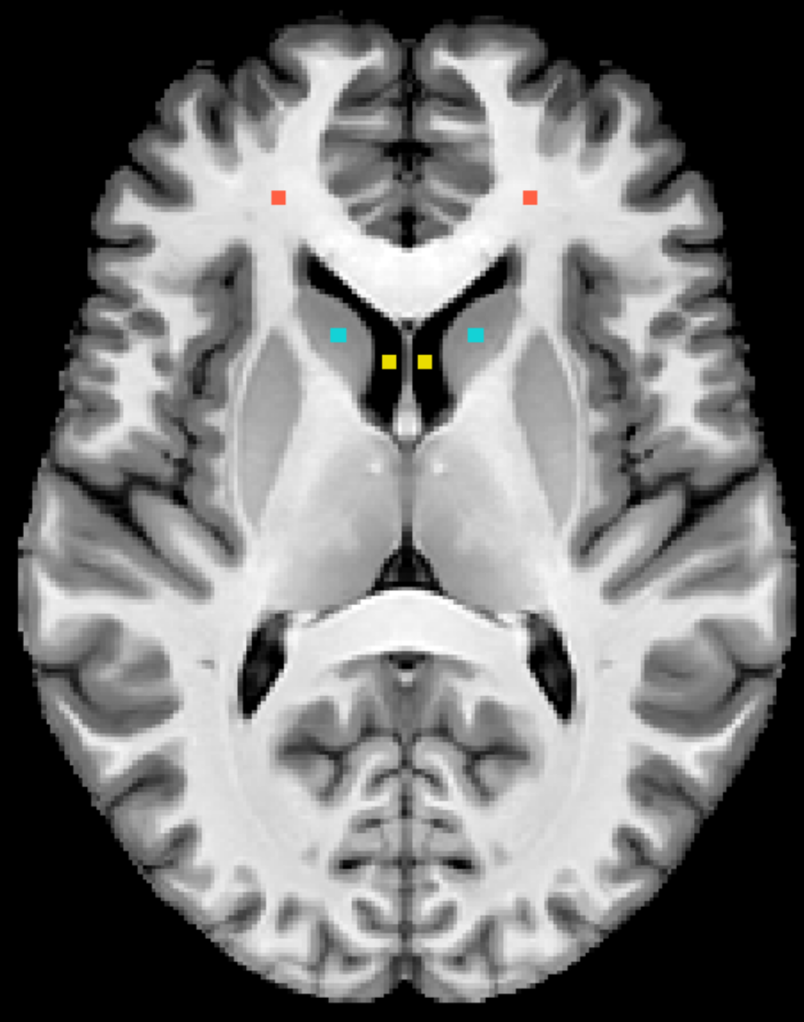
Introduction Methods Results Conclusions
Selection of best weights
3-tissue priors
Contrast-to-noise ratio (CNR)

Slide 12
Introduction Methods Results Conclusions
Selection of best weights
3-tissue priors
Contrast-to-noise ratio (CNR)
Linear discriminant analysis (LDA)

Slide 13
Introduction Methods Results Conclusions
TQ-SILiCON
W_{T1} = 0.31; W_{QSM} = -0.79

Slide 14
Introduction Methods Results Conclusions
T₁w
TQ-SILiCON
1 – Internal capsule; 2 – Thalamus; 3 – Pulvinar nucleus; 4 – External GP; 5 – Internal GP; 6 – Substantia nigra; 7 – Red nucleus

Slide 15
Introduction Methods Results Conclusions
QSM
TQ-SILiCON
White matter

Slide 16
Introduction Methods Results Conclusions
T₁w
TQ-SILiCON
W_{T1} = 0.31; W_{QSM} = -0.79
1 – Thalamus; 2 – External GP; 3 – Internal GP; 4 – Substantia nigra; 5 – Red nucleus

Slide 17
Introduction Methods Results Conclusions
QSM
TQ-SILiCON
White matter

Slide 18
Introduction Methods Results Conclusions
Automatic tissue segmentation
T₁w
TQ-SILiCON

Slide 19
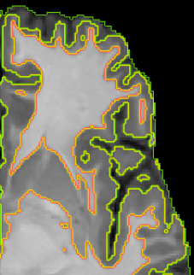
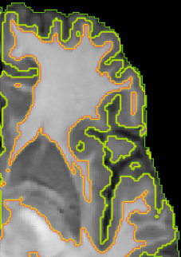
Introduction Methods Results Conclusions
T₁w
TQ-SILiCON

Slide 20
Introduction Methods Results Conclusions
Automatic tissue segmentation
T₁w
TQ-SILiCON

Slide 21
Introduction Methods Results Conclusions
The best of two contrasts are combined in TQ-SILiCON images.
TQ-SILiCON images revealed excellent grey-white matter contrast as well as a distinct delineation of subcortical structures from white matter.
TQ-SILiCON images resulted in an improved grey and white matter tissue classification.
13 minutes TQ-SILiCON data acquisition has the potential to be used in human clinical routine scans.

